Slide 1
Elite Electronics
Revenue and Profit Analysis

Slide 2
Introduction
I Viraj Patel candidate of Stevens Institute of Technology Pursuing Information Systems specialization in Data Analyst.
Project based on Elite Corp sales
Simple Insights:
Revenue breakdown by cities
Revenue breakdown by years and months
Visualization of top 5 customers by revenue and sales quality
Top 5 products by revenue number

Slide 3
Business Opportunities
The customer’s needs and requirements to raise a sales in various states.
Issue:
The Elite sales director facing stiped declined in sales for their various hardware products in different stores such as Surge Stores, Nomad Stores, Excel Stores, and Electrical Stores in the FY 2018 to 2020.
Now is the time:
to identify the target market for these products
to understand how to best brand and position them
to identify issues in product sales, competitors and benchmark their success
The client want proper data visualization to respond to make new business strategy

Slide 4
Aim Gride
Purpose: To unlock sales insights that are not visible before sales team for decision support & automate them to reduced manual time spent in data gathering
Stakeholders: Sales director, Marketing team, Customer Service Team, Data & Analysis Team, IT
Result: An automated dashboard providing quick & latest sales insights in order to support data driven decision making
Success Criteria: Dashboard(s) uncovering sales insights with latest data available
Sales team able to take better decisions & prove 10% cost saving of total spend
Sales analysts stop data gathering manually in order to save 20% of their business time & reinvest in value added activity
Purpose
Stakeholders
Result
Success Criteria

Slide 5
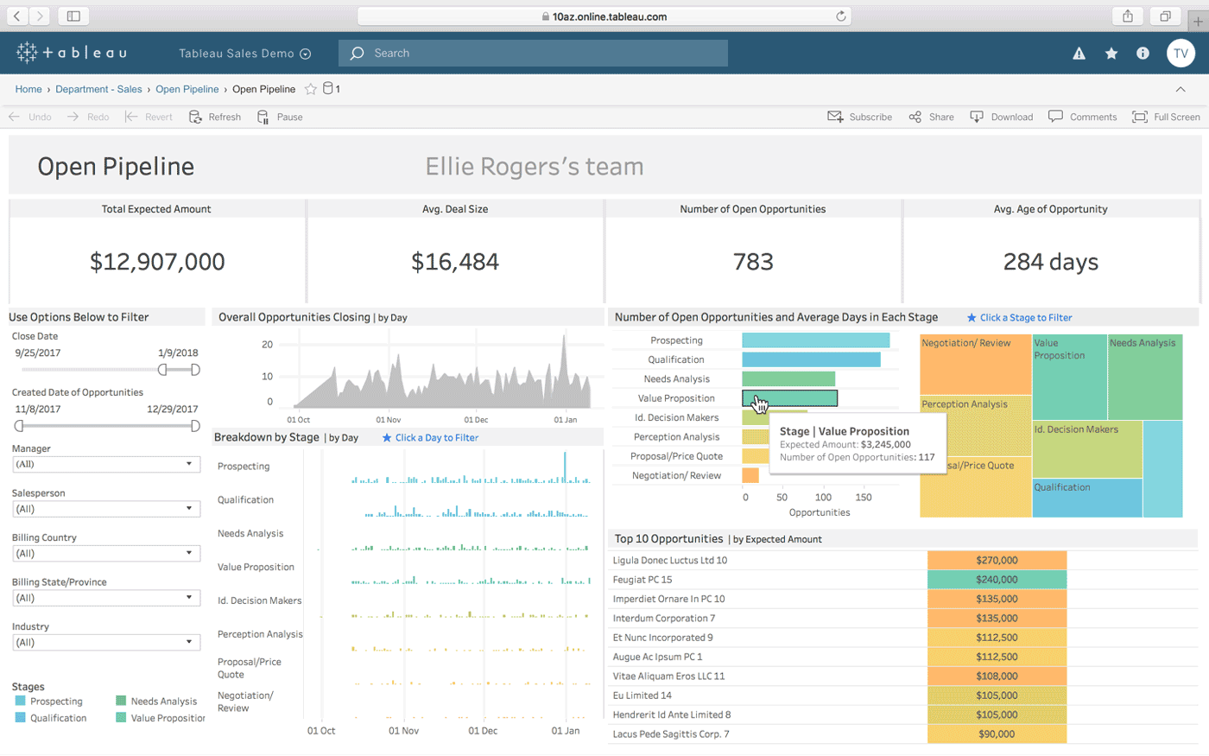
Work Process
Teamwork
mysql
ETL
Data Warehouse
Sales management system
OLTP
OLAP
Soft Engineer
Data Engineer
ETL
Tableau
Data Analysts

Slide 6
ETL (Extract, Transform and Load):
Plugged database from MySQL and retrieved the data and performed ELT
Analyzed the data and performed data cleaning on it such as empty cells, NA, 0 values, and currency conversation in transaction
Real scenario I must use dynamic API for real time currency rate conversation with help of micro service which can provide currency conversation rate on given order date
Eliminated unnecessary data from tables with help of business team
Also, client’s IT engineers has requirement that they don’t want to make any change
After perform all tasks, data is ready to use for implementation and visualize on dashboard

Slide 7
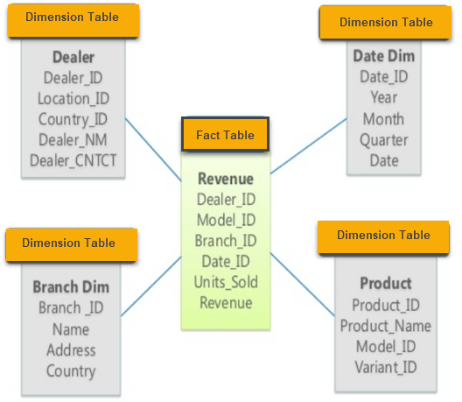
Star Schema
Explanation
Data Model: A model that that connects different tables, and you establish a connection between those tables. It is also known as Star schema
Fact table is heart of star schema called as Fact table and remaining tables are connected to that fact table which are known as transition tables
Fact Table: Transactions
Transition Tables: Customers, Date, Markets, Products

Slide 8
Our Strengths
Durable goods
Electronics
Services
Quality
Consumer Goods and Services
Global Data
Research Network
Geographic Location
Marketing Intelligence
Trends
Industry and Technology Markets
Finance
B2B Services
Machinery
Media
Trade

Slide 9
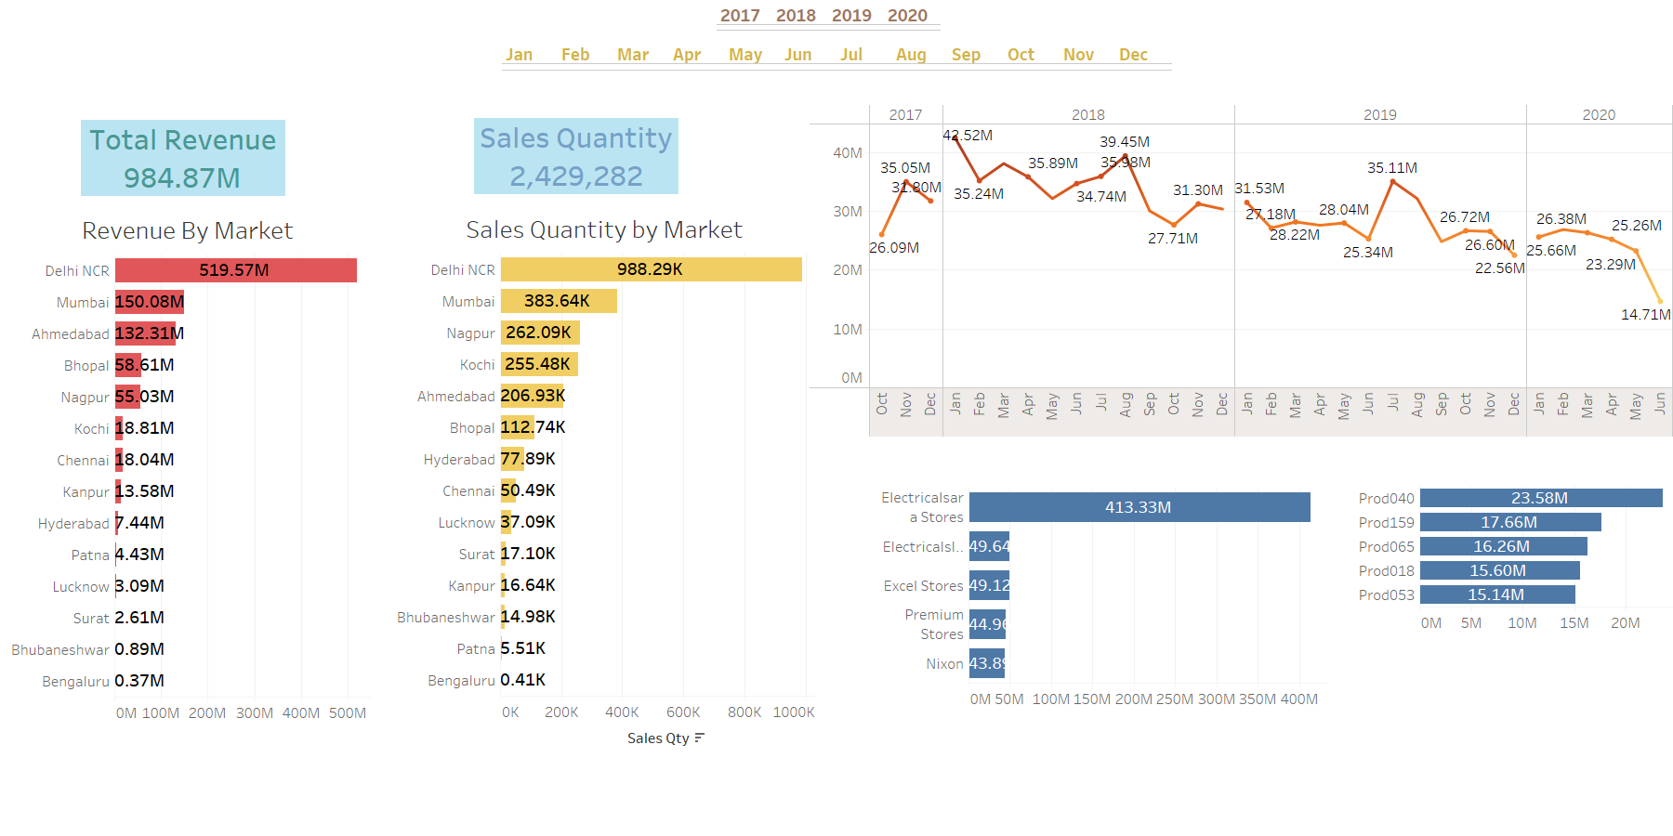
Revenue Analysis

Slide 10
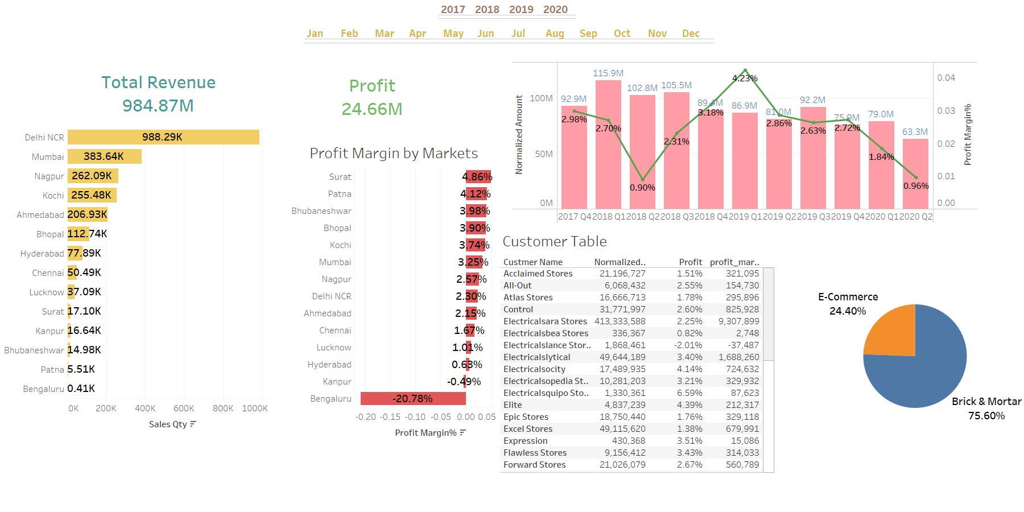
Profit Analysis

Slide 11
Summary of the Analysis
According to last four years of data from 2017 to 2020 build a dashboard that provide a visualization of sales
Bangalore is screwed up the market, it is making to much loss which is more than 20%
Delhi making more sale, but the highest profit made by Bhuvneshwar given a maximum profit
Make more focus on top three region Bhuvneshwar, Hyderabad, and Chennai need to increase the sales
Leader customer give the maximum margin to the company

Slide 12
Key Benefits of Product or Service
Conclusion:
Investment in market research is an investment in your product’s success!
Know your customer
Know your competition
Timing is everything
Track and adjust

Slide 13
Thank You

